Slide 1

Lesson 5
Model of neuron

Slide 2
Plan
Recap of linear models
Recap of gradient descend (GD)
SGD
Neuron
Training neuron
Activation functions

Slide 3
Linear Regression Recap

Slide 4
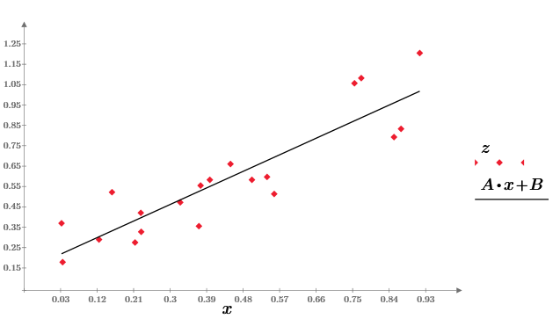
One-dimensional regression
(x,y) - pair of dots
Problem: make a prediction of unknown y given x in assumption y(x) is linear function
y=Ax+B

Slide 5
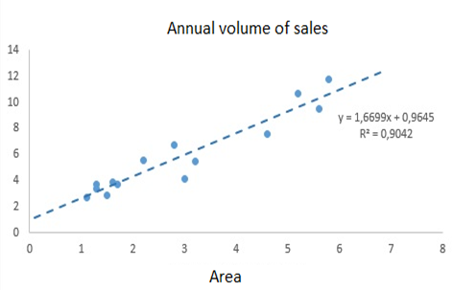
Example
Our goal is to predict volume of annual sales for all of new shops given their area.
y=Ax+B

Slide 6
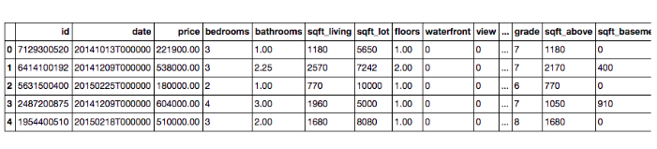
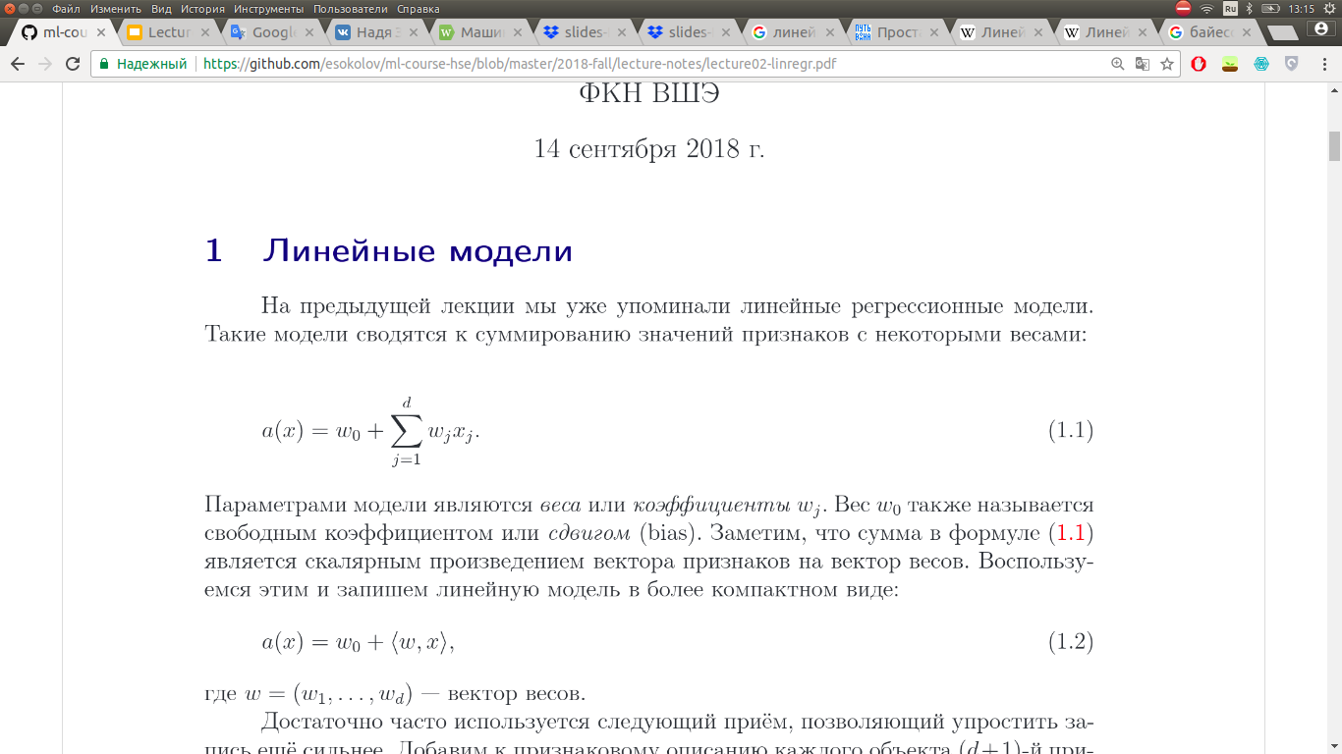
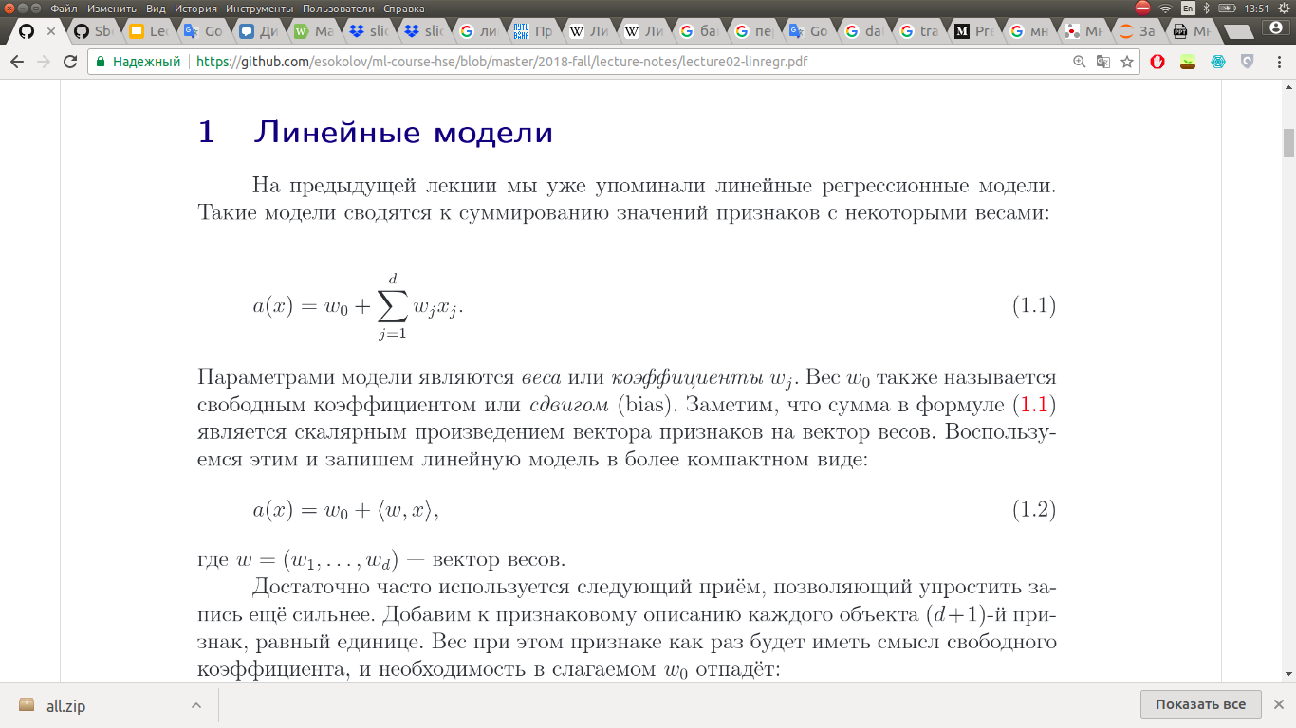
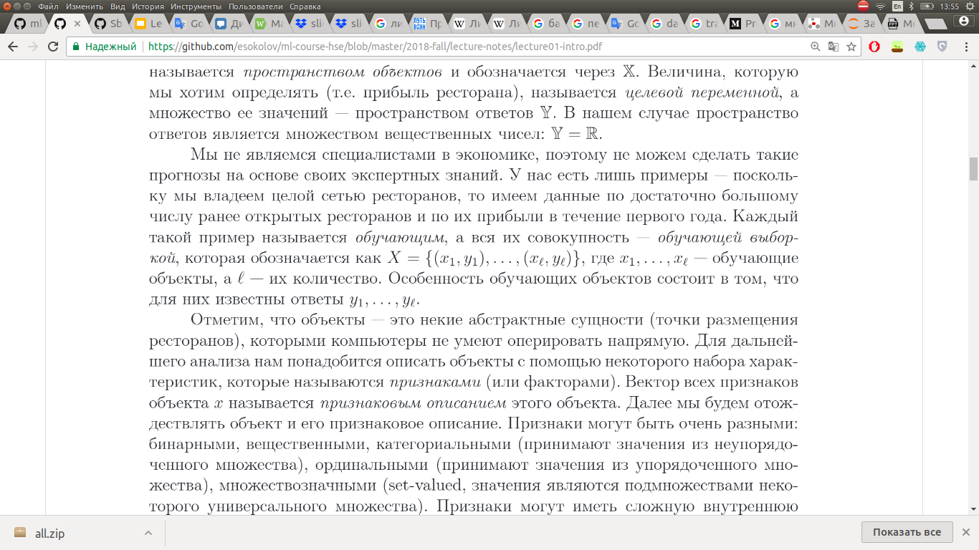

^

Slide 7
^

Slide 8
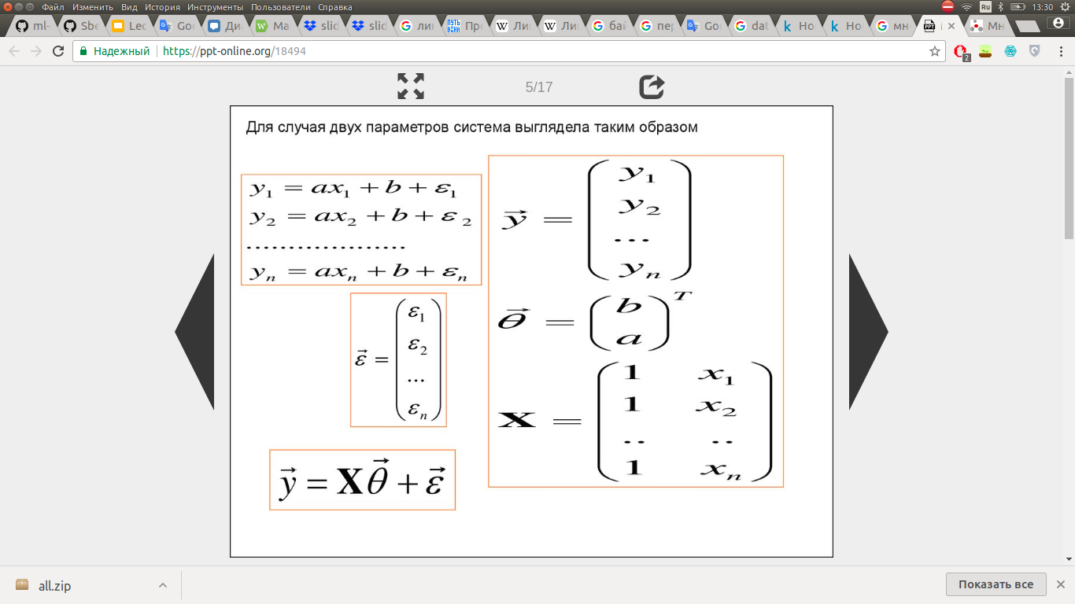
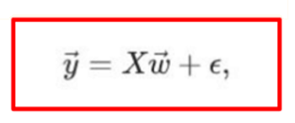
Matrix form

Slide 9
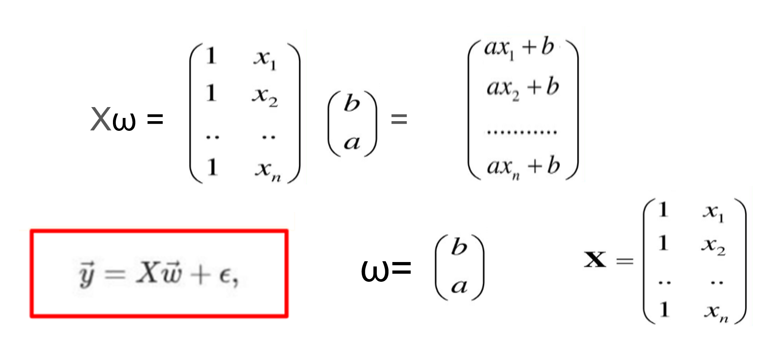
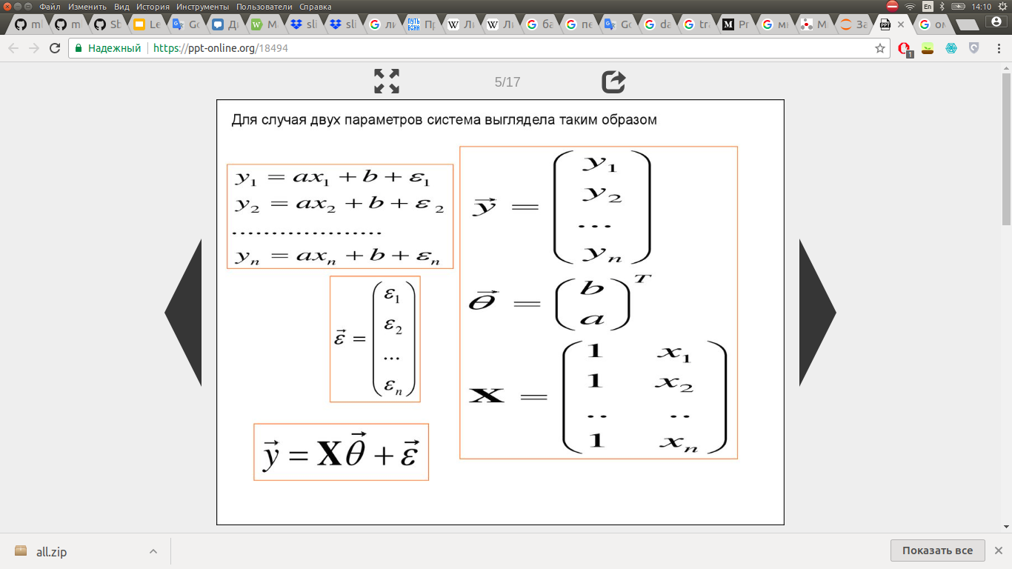

Fictitious variable (case of 2 parameters, n objects)
https://ppt-online.org/18494
Xω = =
ω=

Slide 10
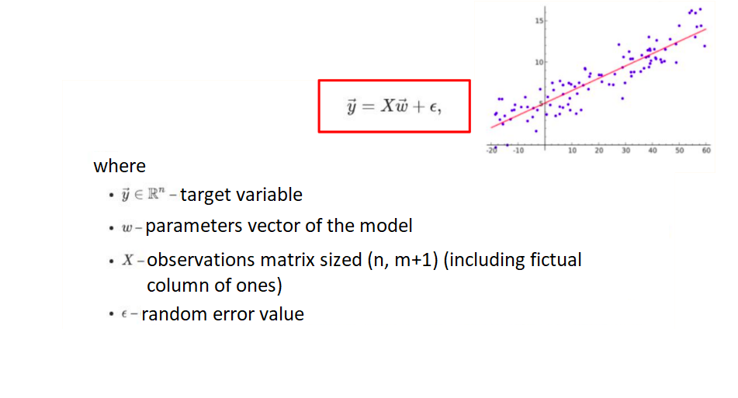
Linear regression

Slide 11
Gradient descent
Recap

Slide 12
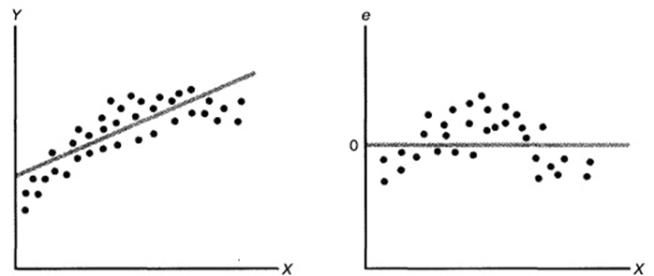
Forecasting

Slide 13
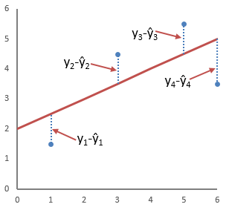
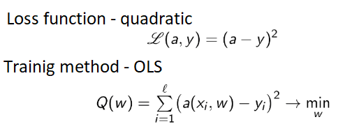
Ordinary Least Squares, OLS(one-dimensional case)
http://www.machinelearning.ru

Slide 14
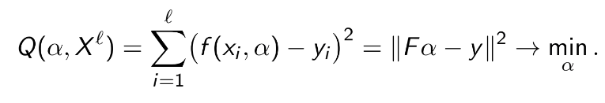
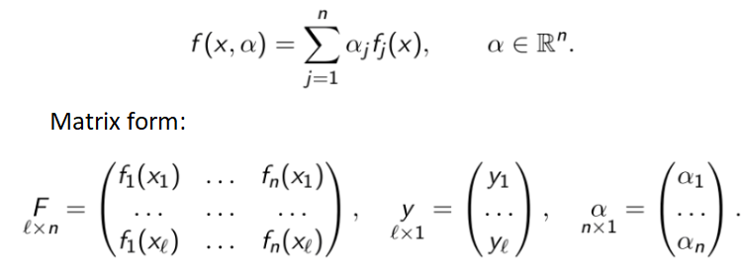
OLS (multi-dimensional case)
http://www.machinelearning.ru

Slide 15
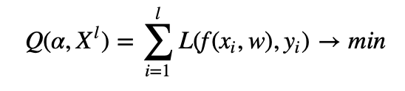
General case
http://www.machinelearning.ru

Slide 16
Gradient descend
http://www.machinelearning.ru
Goal is to find parameters vector
We can minimize error by minimizing loss function

Slide 17


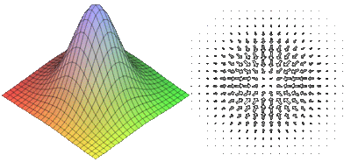
Gradient

Slide 18
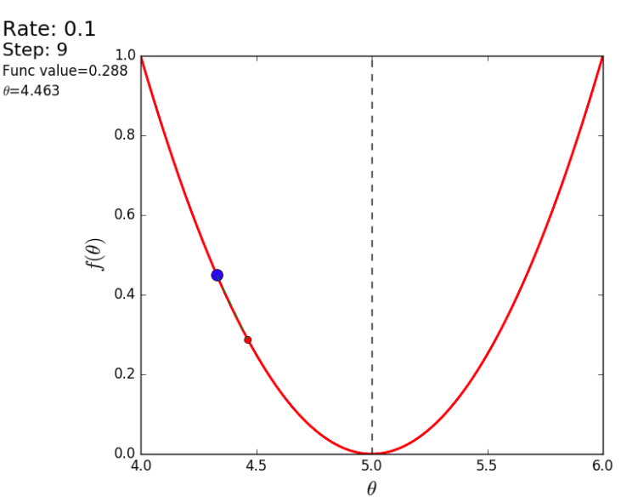
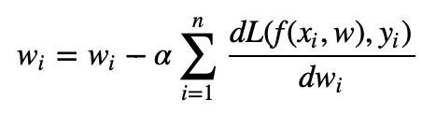
Gradient descent (GD)
http://www.machinelearning.ru

Slide 19

“Running down the mountain with a flashlight”

Slide 20
Gradient descent (GD)
Sum all gradients for every object in dataset
Update weights after computing derivatives for all objects in dataset
Algorithm:
Repeat until converges:

Slide 21
Stochastic gradient descend

Slide 22
Stochastic gradient descent (SGD)
Compute gradient for one object in dataset
Update weights every time after computing derivatives for one object of dataset

Slide 23
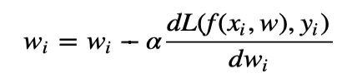
Algorithm GD:
Repeat until converges:
Algorithm SGD:
Repeat until converges:
for i in range(len(X_train)):

Slide 24
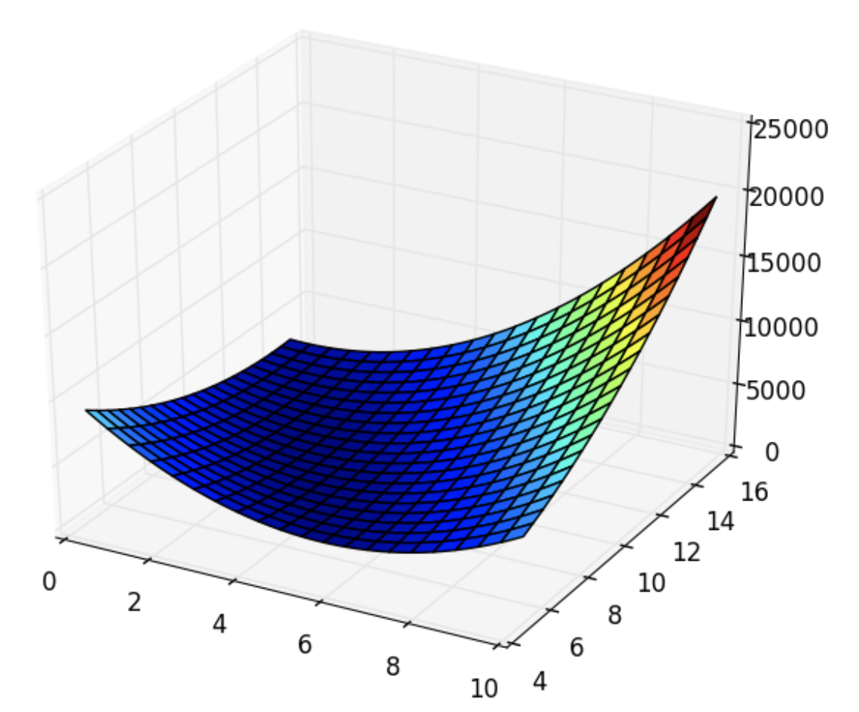
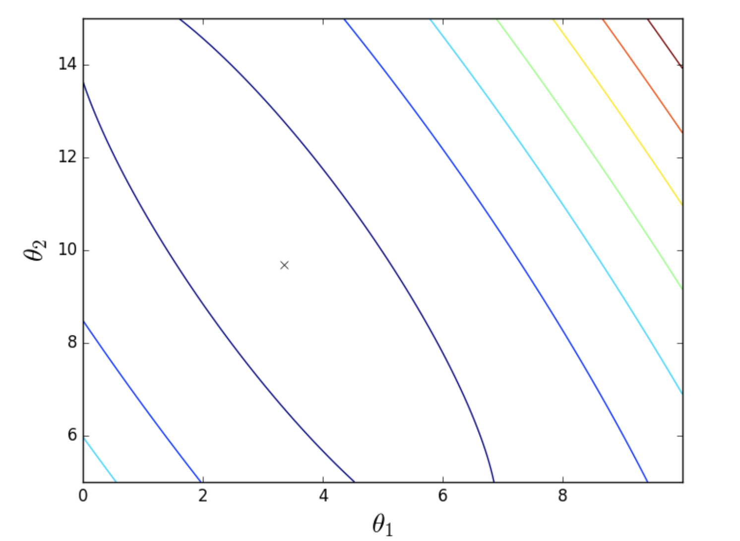
GD vs SGD
Top view:
cross – minimum, target for algorithm
Loss function (it’s smooth!):

Slide 25
GD

Slide 26
SGD

Slide 27
GD vs SGD
SGD updates weights faster, but takes more steps to converge
SGD works well with functions with lots of local minima – every step there is a chance of algorithm jumping out local minimum therefore final solution will be more optimal, than GD
GD is good for convex functions – it converges to local minimum confidently

Slide 28
GD vs SGD
Trade-off?
Mini-batch gradient descent
Zero out gradients after every mini-batch.

Slide 29
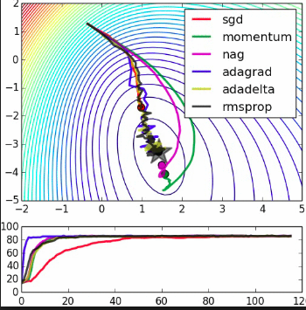

Slide 30
Neuron

Slide 31
Linear classifier
How can we make linear classification from linear regression?

Slide 32
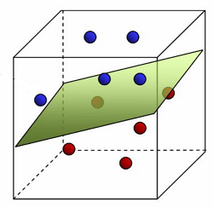
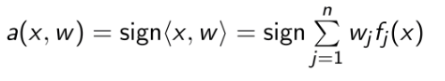
Linear classifier
How can we make linear classification from linear regression?

Slide 33
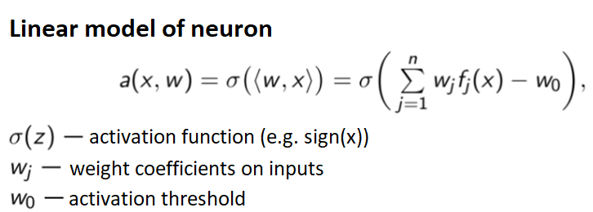
Linear classifier as neuron model
http://www.machinelearning.ru

Slide 34
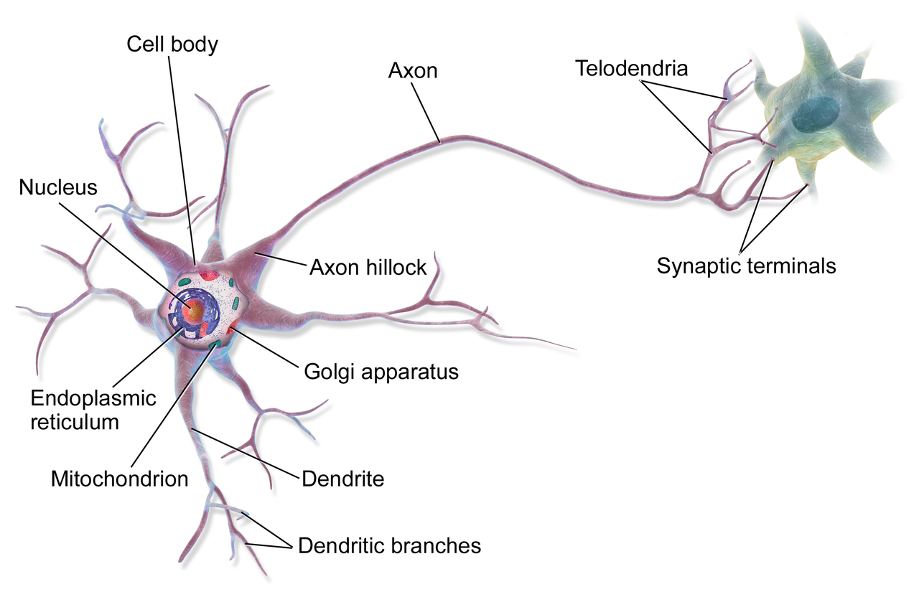
Biological neuron

Slide 35
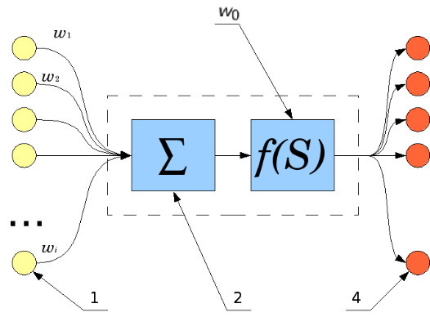
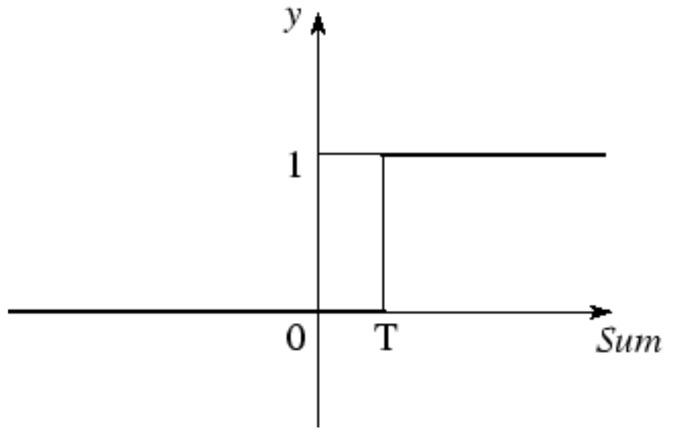
Artificial neuron

Slide 36
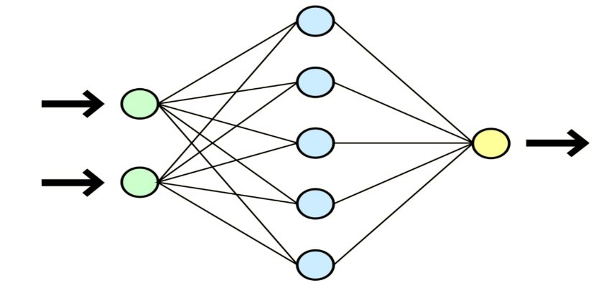
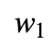
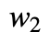
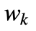
Neural network

Slide 37
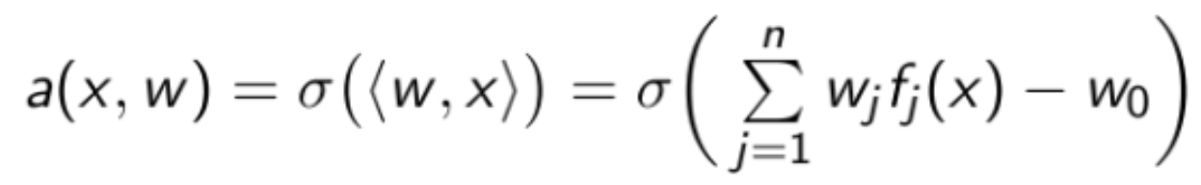
Neuron: learning
Training with gradient descent:

Slide 38
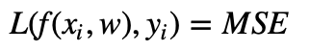
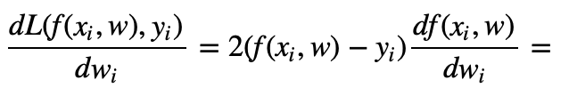
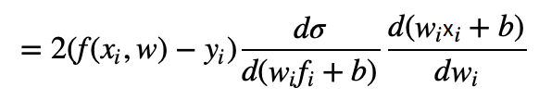
Neuron: learning
Example with

Slide 39
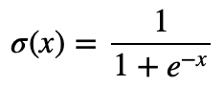
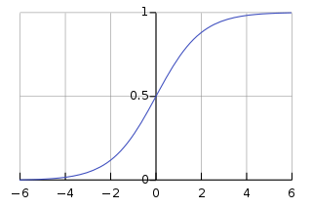
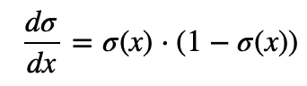
Neuron: activation functions
Sigmoid:
Range of a function: [0, 1]
What values is this function suitable for?

Slide 40
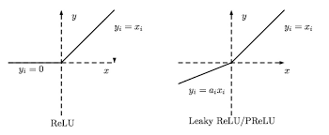
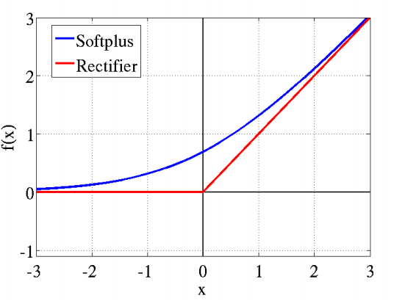
Neuron: activation functions
Other activation functions:
Relu
LeakyRelu
Softmax
Tanh
ELU
...

Slide 41
Links

Slide 42
https://www.youtube.com/watch?v=-7scQpJT7uo - Which Activation Function Should I Use?
You must check this article by Stanford: http://cs231n.github.io/neural-networks-1/
Great article on activation functions: https://www.jeremyjordan.me/neural-networks-activation-functions/

